Slide 1
Deep learning strategies for LST and SST retrieval using IASI observations
Eulalie BOUCHER¹, Filipe AIRES¹, Victor PELLET¹
1 LERMA, Observatoire de Paris, CNRS, Paris, 75014, France
Notes:
My presentation will be on Deep learning strategies for land surface and sea surface temperature using IASI observations.

Slide 2
Context
Traditional Neural Networks (NN) have been popular in the satellite remote sensing community for the last 20 years. Inversion schemes can be physical or statistical. In particular, NNs have proven to be very efficient to perform such retrievals in the atmosphere (Butler et al., 1996), in the ocean (Aires et al., 2013), and over the continents (Aires et al., 2002a, 2002b, 2002c, 2002d), in particular with IASI observations (Aires et al., 2002a, 2002b; Blackwell, 2005; August et al., 2012; Paul et al., 2012; Safieddine et al., 2020).
For coarse resolution infrared instruments like IASI, these NNs have been designed for a retrieval at the pixel level.
Notes:
For a little context on the use of statistical approaches for remote sensing,
Traditional Neural Networks have been popular in the satellite remote sensing community for the last 20-30 years. Statistical inversion schemes have proven to be very efficient to perform such retrievals in the atmosphere, in particular with IASI observations.
However, for coarse resolution infrared instruments like IASI, these NNs have been designed for a retrieval at the pixel level. The neighboring pixels are therefore not taken into account.

Slide 3
Motivation
Compare traditional Neural Networks (NNs) and Deep Learning (DL) approaches for the retrieval of surface temperature (TS), with a focus on reducing regional biases :
→ Are Deep Learning strategies useful to retrieve surface temperature from IASI observations ?
2. Facilitate the assimilation of IASI temperature products by:
Training on ECMWF ERA5 TS
And estimating retrieval uncertainties
Notes:
The motivation of this work is therefore, firstly, to compare these traditional neural networks performed at the pixel level and deep learning approaches which are mostly based on image processing techniques for the retrieval of surface temperature as I said.
We focus on reducing regional biases, a phenomena that I will define in a couple of slides. Secondly, we want to facilitate the assimilation of IASI retrieved products, in this case temperature products by performing the training of the networks on ECMWF ERA5 model Skin temperature product and estimating retrieval uncertainties, which is necessary for the assimilation process.

Slide 4
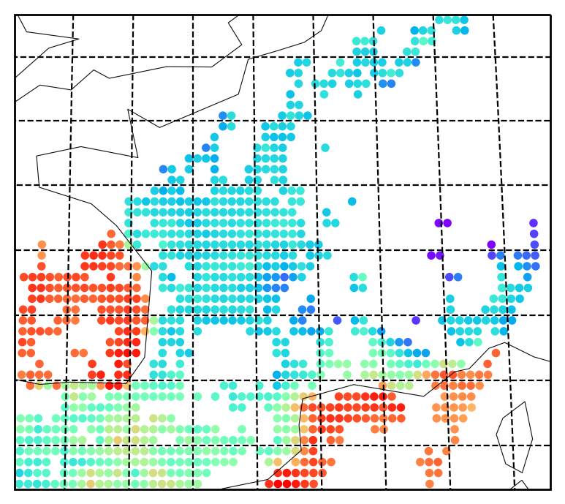
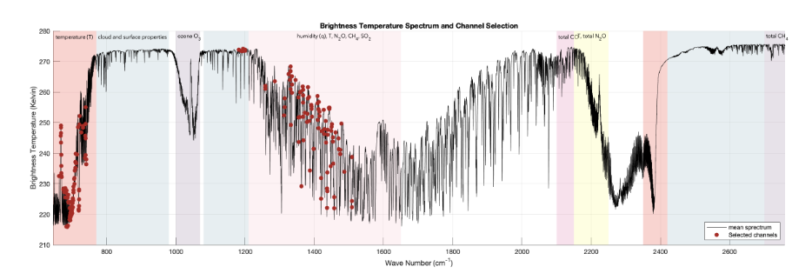
Database: data representation
One pixel
3 principal components (depth of the image)
Channel selection
PCA Compression
Brightness temperatures from 8461 IASI channels (TBs)
Channel selection
PCA Compression
(Pellet, V., F. Aires, 2018.)
Notes:
The data that we have is under the form of brightness temperatures.
For each pixel, we have the IASI spectrum made of 8461 channels. Different parts of the spectrum give different information about the surface or the atmosphere. We use an algorithm of channel selection followed by a PCA compression in order to obtain 3 principle components which will represent the three inputs to the networks. These principle components contain almost all of the information on the surface properties that can be extracted from the spectrum.

Slide 5
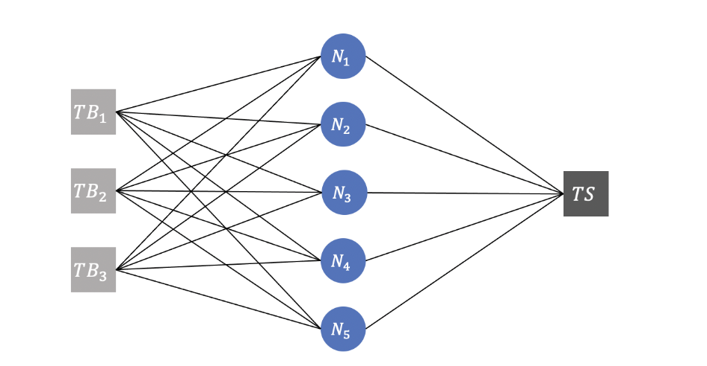
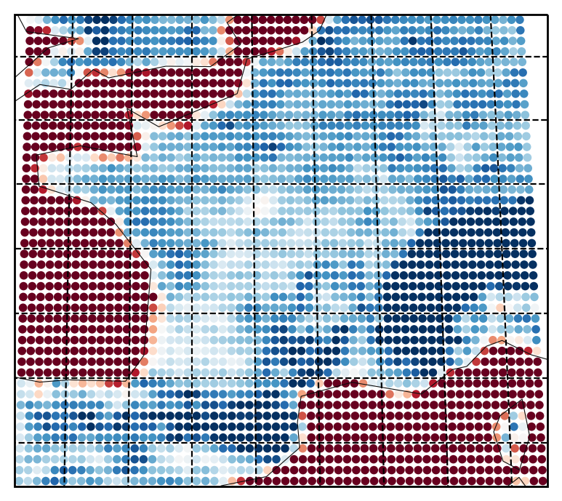
Methodology – Multilayer Perceptron (MLP)
(Paul, M., F. Aires, and C. Prigent, 2012., Safieddine, et al., 2020.)
Traditionally: MLP are applied at the pixel scale => the networks must make trade-offs between all the pixels
This results in regional biases because an unbiased estimator = unbiased globally, but not regionally
Objective: to see if localization (localization variables or image processing approaches) can reduce these biases
Localization of an MLP: Adding localization variables such as Land Fraction, Altitude, … even Lat, Lon.
Pixel:
3 PCs
Bias (K)
Notes:
So as I said, generally, what we call traditional neural networks are used at the pixel scale. These NNs are generally multilayer perceptrons (MLPs) which consists of several interconnected layers of neurons, where each neuron in one layer has direct connections to neurons in the next layer.
When applied at the pixel scale, the networks are generally trained on all pixels, either over the entire globe, or over a chosen region.
The task they are asked to perform is thus very ambitious since the retrieval is expected to function everywhere. This results in regional biases I was talking about earlier. Indeed, although MLPs are unbiased estimators, this is over the whole dataset, not regionally. Actually, what creates these biases is the fact that the network must make trade offs between what happens over one part of the globe and what happens over another. For example, if you look at the map here which represents the average bias between the retrieval and the ERA5 skin temperature product over each pixel, you can see that we have systematic regional biases over certain parts of the chosen domain, notably we observe the land/sea contrast.
Not only do these regional biases impact the quality of the retrieval, but they also cause a problem when assimilation into Numerical Weather Prediction (NWP) models. An important aspect of assimilation is that the assimilated data needs to be coherent enough with the numerical model in order to avoid alternating values between the satellite observations and the model climatology in the time series of the model variables. Our objective is therefore to see how we can reduce these biases, and more specifically how localizing the network could help.
Incorporating localized information within the inputs of the MLP can be done in several ways:
Either by introducing more variables into the inputs. This can be physical variables like the land fraction, the altitude of the surface emissivity for an attempt to obtain a general radiative transfer applicable to any location. Or we can also add latitude and longitude of each pixel, but this is a less physical approach which is also less effective.
Another way to localize the MLP is by training independent MLPs for each pixel. This allows the MLP to focus on the relationship between TBs and~TS at a certain location only, and the missing physical variables are supposed in this case to not change for a particular pixel so they can be omitted.

Slide 6
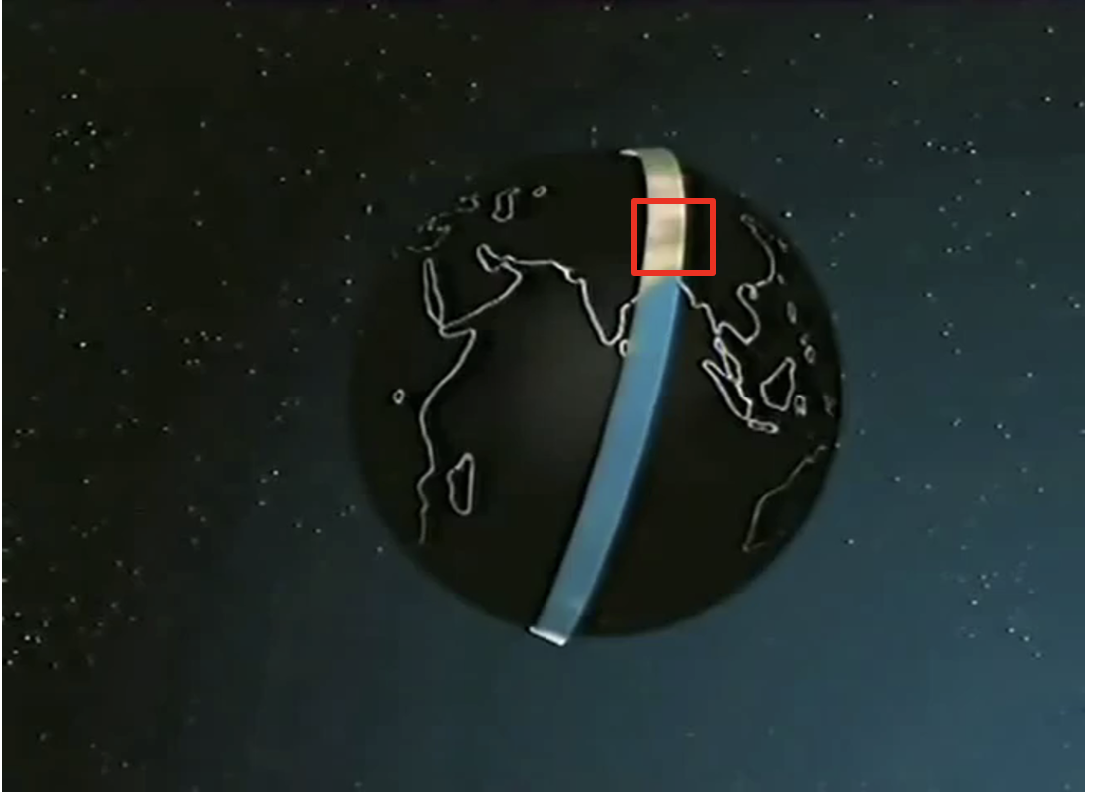
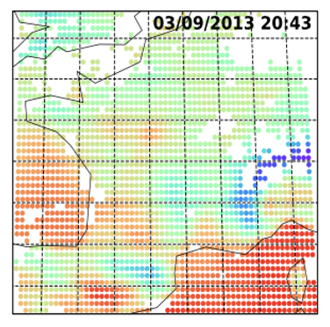
From pixels to images
IASI is placed onboard polar orbiting satellites (MetOp)
= complex acquisition geometry that is NOT an image
The choice was made here to work on stationary domain as opposed to generic images (Aires, Boucher, Pellet, 2021)
More potential to exploit spatial structures and benefit from CNNs
Domain focused over France and its surroundings
Missing data has to be filled, due to orbits and clouds
Notes:
Localization can also be done by moving onto an image processing approach, in which we add the spatial dimension.
To use such techniques, as the name suggests, we need images. However, IASI data, and more generally data from polar orbiting satellites, are NOT in the form of images
The choice we went with is working on a stationary domain. We focused on a domain surrounding France and its surroundings and each time an orbit passes over this domain, we get an image. Another method would be to take fixed size images over the entire globe. This approach was tested last year in an SST retrieval context, but it was concluded that spatial patterns were not detectable enough in that scenario.

Slide 7
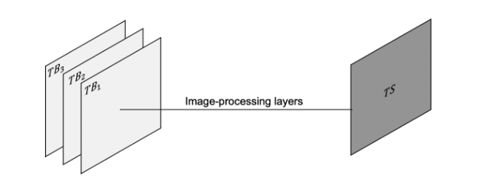
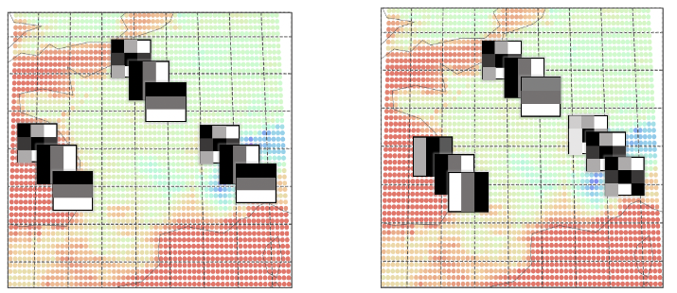
Methodology – Convolutional Neural Networks (CNN) and Localized CNNs )
Image processing approach
Classical CNN - Spatial filters are the same on the whole image: weight sharing.
Localized CNN - Specialized filters for each part of the image.
Useful for us: specific environment inland, over the sea, over the Alps...
Should help to reduce regional biases
Classical CNN Localized CNN
Notes:
Once we have data under the form of images, we are able to use Convolutional Neural Networks (CNNs) which is one of the most widely used classes of deep learning models.
The typical architecture of a CNN is a stack of layers transforming the input into an output using mostly convolutions. The convolutional layer, consists in a set of filters who are trained to activate when it detects a particular type of spatial feature in the image.
In a classic CNN, the concept of weight sharing is applied. This means that the same convolution filters are applied throughout the entire image.
Since we are working on a fixed spatial domain, the different parts of the image are always in the same physical location on the Earth's surface. This means that for each location of the image, a limited number of specific convolution kernels could be found instead of using a large number of generic kernels applicable everywhere.
This is exactly what the local convolutional layer does. It works exactly in the same way as the well-known convolutional layer apart from the fact that the parameters are not shared throughout an activation map. This means that the kernels being convolved vary with the location.
Looking at the figure here at the bottom, we can see that for a classic convolutional layer, each of the three kernels illustrated is passed throughout the whole image. For the local convolution, the kernels differ for different locations, the CNN is therefore localised.
Considering our objective, the localized CNN is an important feature that we believe could help us since we observe different environments when we are over land than when we are over the ocean or the Alps. This should help reduce regional biases.

Slide 8
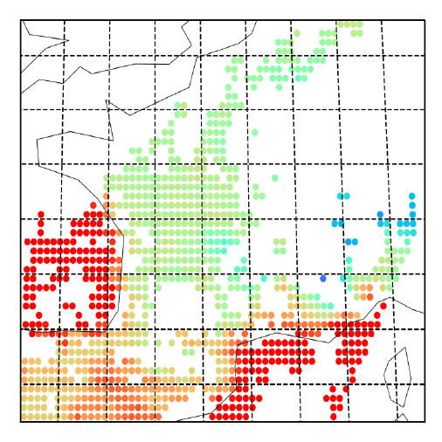
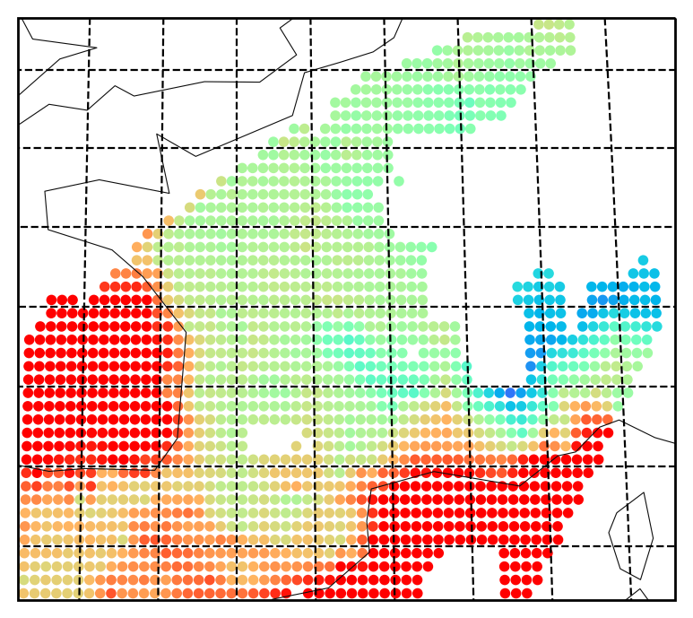
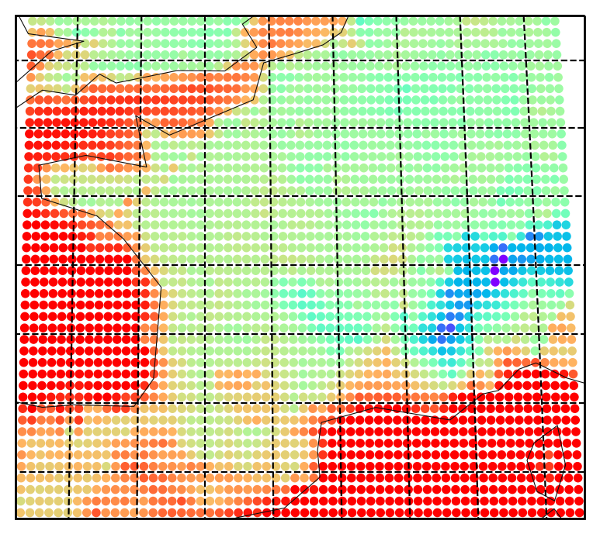
Dealing with missing data
Bilinear interpolation for smaller holes
PCA-based extrapolation for larger holes
1. Extract EOF from clear pixels in the database
Representation of an image by PCA:
X $=λ_{1}F_{1}+λ_{2}F_{2}+ …+λ_{m}F_{m}$
2. First guess
3. Optimization : $\min_{Λ} X −ΛF$
Notes:
The choice of working with images comes with a cost which is missing data. First, there is missing data that is caused by orbits only partially covering the domain sometimes. The orbits pass over the chosen domain 2 or 3 times a day, but only once fully covering it. Furthermore, when dealing with images, we naturally have to deal with cloudy skies. In a pixel-level processing scheme, the cloudy pixels are ignored and the inversion is performed only on clear pixels.
A CNN needs completed images and this is the biggest challenge to overcome when using CNNs in remote sensing. In the literature, nothing satisfying was presented, it is generally suggested to fill missing data with constant values, but this isn’t a valid option since we have so much missing data, this would mislead the CNN.
We distinguish two types of missing data.
Holes where we have some neighborhood information which we can make use of. This is interpolation which we do using a simple bi linear interpolation method. The results are shown here.
The second type of holes are whole missing parts of the image like we see here. For these holes, we need to use a PCA whose goal is to find important spatial patterns. This PCA is applied on whole images, so the extracted spatial filters are images. For example, we hope that one of these patterns could represent the contrast between land and sea. By the constraint of non-missing data we have in the image, we constrain those spatial patterns in the missing parts of the image and optimize the extrapolation in such a way that it.
This method is used to obtain filled images of IASI brightness temperatures and also on ERA5 skin temperature. This will This way, we are able to train the CNNs on these filled images, but we only consider and analyse results on pixels which were clear in the first place.

Slide 9
Comparing Localization Strategies
We test the following strategies:
A single MLP model trained on all pixels of the domain (General MLP)
A single MLP model trained on all pixels of the domain with additional localization variables (General MLP with localization variables)
A MLP model trained independently on each pixel of the domain (i.e. 2640 MLP models) (Pixelwise MLP)
A standard CNN model
A localized CNN model
Notes:
I will present the results obtained with the following strategies:
A single MLP model which is trained on all pixels of the domain. The input to this network is simply the 3 principle components of the IASI brightness temperature.
The same MLP model, but to which we add additional variables in input. I will present the results where the localization variables we add are the Land Fraction, the Altitude, the Surface emissivities and the latitude and longitude.
The third localization strategy we studied is training an MLP model independently on each pixel of the domain. This means we have 2640 different MLP models. The inputs again are only the brightness temperatures.
Moving onto the image-processing strategies, we compare a standard CNN model with 4 convolutional layers, each respectively with 64, 32, 16 and 8 kernels.
and a Localized CNN model, with only one local convolutional layer with one filter.

Slide 10
Comparing Localization Strategies
General MLP with localization variables
Individual MLP
Localized CNN
General MLP
Generic CNN
Reduced biases with the introduction of localization information
Residual error and bias is due to the inherent physical difficulty of the inversion process
Localized image processing approach yields similar results to an MLP trained independently on each pixel
RMSE (K)
STD (K)
BIAS (K)
Notes:
First here we have the results from the simplest solution of training a single MLP model over the entire spatial domain and using only the TB information. We see that this leads to high regional biases, even if the spatial domain is not large compared to a potential global recovery. A single network cannot capture the subtilities of the independent TBs/TS relationship found in each pixel of the domain.
By adding location information as input to the same model, regional biases are significantly reduced, especially over complex areas. Location information is beneficial for the MLP, but it is better here to add only "physical" variables. For example, experiments have shown that adding non-physical variables such as latitude and longitude requires more neurons in the hidden layer than adding physical variables.
A great improvement can be observed by using pixel-by-pixel MLP models: with only 5 neurons in the hidden layer for each MLP model, almost no regional bias is observed over the problematic regions (especially the alpine region) because each MLP is specialized to one pixel location. These models do not have to trade off between regions and the remaining error and bias especially over the Alps is inherent to the true physical difficulty of the inversion process in these locations.
Although localized by the nature of the image processing approach, the generic CNN model produces considerable error over the problematic regions, again primarily bias errors.
On the other hand, the localized CNN model produces much smaller bias errors. It is also the model that produces the lowest error overall. The localized convolutional layer captures dedicated spatial patterns at each location to aid inversion.
Overall, the two networks that perform best in terms of error and regional bias reduction are the individual MLPs and the localized CNN. The residual error and bias on these two methods is due to the physical difficulty of the inversion process.

Slide 11
Localized CNN Results
EUMETSAT PWLR³ TS
Difference Retrieved – ERA5
Difference Retrieved – PWLR³
ECMWF ERA5 TS
Retrieved TS
Two localized CNNs (night/day)
Excellent quality retrieval
Root Mean Squared Error:
0.96 K on sea,
1.83 K on land,
2.50 K on the Alps,
1.85 K on coastal areas.
Notes:
For the rest of this presentation, we will focus on the results yielded by the localized CNN since we were keen to further analyze and understand the functioning of image processing techniques. To be the most coherent, we train two separate networks for daytime and nightime TS retrieval. Here two examples of retrieval. On the left is the surface temperature target, coming from ERA5 model, then here the EUMETSAT operational retrieval, and then on the right here what we predict. The results are of excellant quality. We obtain less that 1K over sea and less that 2K over land.
We see the difference between our retrieval and ERA5 and also between our retrieval and EUMETSAT here on the right. We can see that we are close to white which is 0 difference so this shows the quality of the results. The errors are homogeneous, which shows that we have well managed to reduce regional biases.
The comparison with Eumetsat TS is also useful because Eumetsat uses IASI data as well as microwave data for their TS inversion and trains their algorithm on the TS of ERA5 as well. We can therefore say we share the same objective as them and this makes our results perfectly comparable.
In fact, our tests showed that the obtained error between ERA5 and EUMETSAT is almost identical than between the retrieved TS and EUMETSAT durig the daytime. This is already an excellent achievement, because we are using a simple, single layer CNN, as opposed to a much more complex inversion algorithm used by EUMETSAT. This shows the effectiveness of using a localized CNN, and more generally of using localization within the retrieval algorithm.

Slide 12
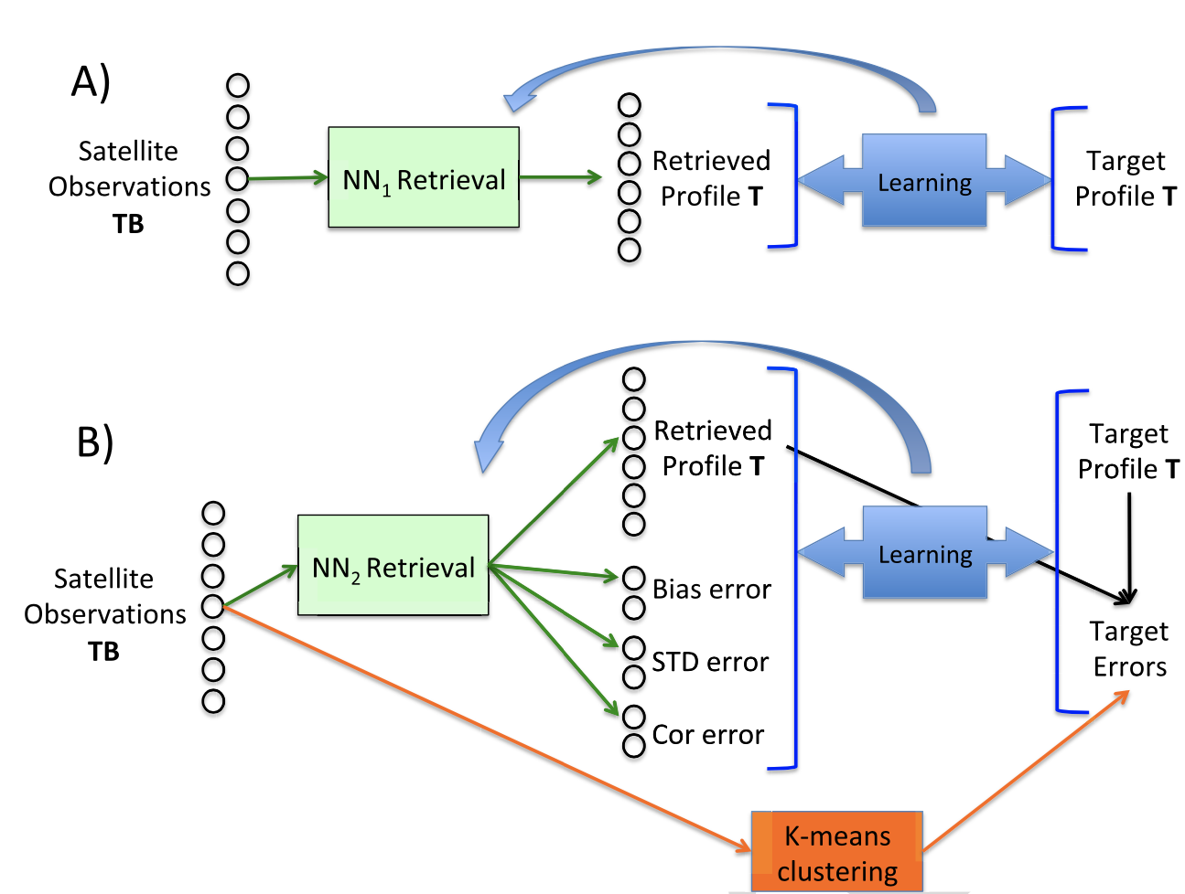
Estimating Retrieval Uncertainties: A two-step process
The information provided by the observations can be raw radiances R or retrieved products P
Assimilation into a NWP model: model / observations are weighted, based on their respective uncertainties.
Since reliable uncertainties on retrieved products are difficult to obtain, the assimilation of raw radiances R has been privileged (one of the reasons)
To facilitate the assimilation of retrieved products, the estimation of retrieval uncertainty is necessary
Based on a simple, easy-to-implement scheme based on the input space clustering presented in (Aires and Pellet, 2021)
Notes:
Moving onto estimating retrieval uncertainties.
As I said, an important source of information for assimilation in NWP models is satellite observations, and two approaches can be considered: the assimilation on the raw radiances (TBs) or the assimilation of the retrieved products (TS). In both cases, the model is weighted based on their respective uncertainties. Therefore, an uncertainty estimate for the satellite information is necessary.
In the past, the first option was often preferred. A major reason for this is the difficulty to obtain uncertainty estimates of retrieved products. However, the RT calculations are less accurate for surface simulations due to parameters such as soil texture and surface emissivities being difficult to obtain. Therefore, the assimilation of a retrieved product is a viable alternative, especially when uncertainty estimates are available.
What we currently have is an NN or CNN retrieval of the surface temperature and Ideally, we would like to be able to predict the surface temperature distribution for each observation instead. In the literature, there is an algorithm called Quantile regression neural network which tries to predict the quantiles but Preliminary tests done within the research group at the LERMA showed that this method was not working very well in the practical case because the input information does not allow us to characterize the subtleties of the distribution.
Therefore, we concentrated on trying to predict only the std of that distribution and the method we use is based on a simple, easy-to-implement scheme based on the input space clustering presented in a paper by Aires and Pellet; however, we need to adapt the method to the use of image-processing approaches.

Slide 13
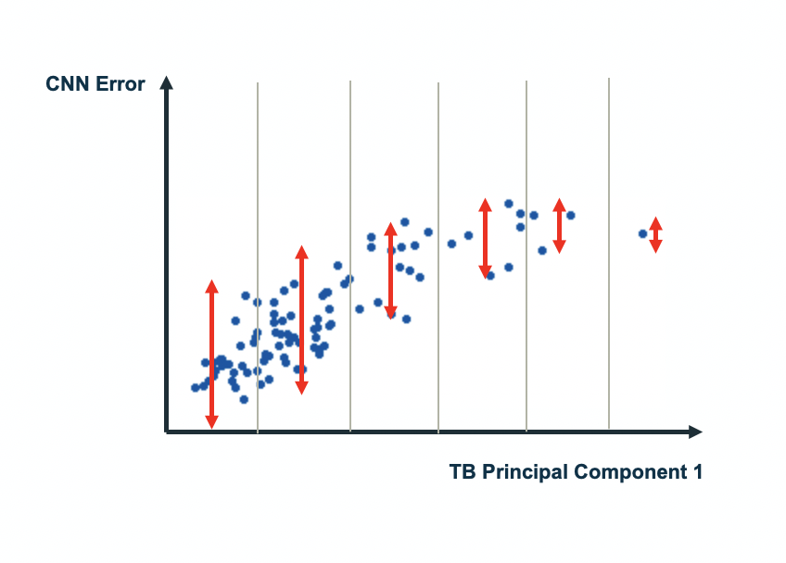
Estimating Retrieval Uncertainties
Estimating Retrieval Errors From Neural Network Inversion Schemes – Application to the Retrieval of Temperature Profiles From IASI, F. Aires & V. Pellet
Algorithm to perform the retrieval of TS and simultaneously estimate the retrieval error:
Bin the input space : for each pixel 6 bins based on quantiles of the TB PC distribution
Calculate STD of CNN-retrieval error for each bin
Re-train CNN to retrieve simultaneously TS and its associated uncertainty
Notes:
To do this, we opt for a very simple solution which is based on binning the input space. Here we show the error obtained by the CNN retrieval against the first principle component of the TB. In each bin, we calculate the std of this error distribution.
These stds are what we want the network to learn. So we retrain the same CNN which retrieves both the TS and this std that is characterized by its input values.

Slide 14
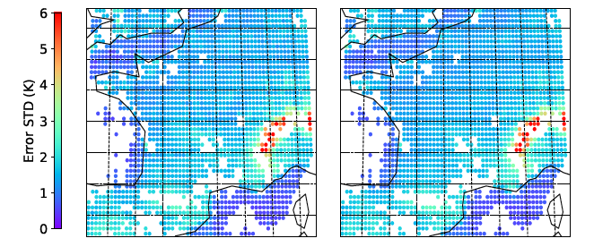
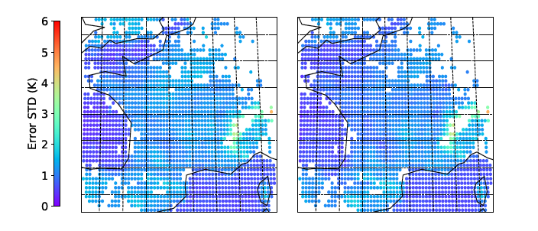
Estimating Retrieval Uncertainties: Results
TARGET STD
RETRIEVED STD
State-dependent retrieval
Higher errors in more complex areas
STD ERROR (K)
Notes:
Here we show the results obtained on two examples. On the left we have the target std we want to retrieve, and on the right our prediction. We can see that the two are practically identical and that the network managed very well to retrieve the std of the distribution. We can see that naturally, errors are very close to 0 (dark blue) in the ocean, and are higher in complex areas such as the Alps. This shows the state-dependency of our uncertainty retrieval.

Slide 15
Conclusion
Compared different localization strategies, aiming to reduce regional biases
Localized CNNs offer a combination of a pixelwise approach in problematic (coastal and mountainous) areas and utilizes the spatial dependency in areas where strong spatial features are detected, thus providing excellent retrievals and reducing regional biases
Multiple individual NNs at the pixel level offer also a good alternative, easier to implement.
Choice depends on the type of variables to retrieve (heterogeneity, spatial coherency, etc.)
We propose an easy-to-implement and straightforward estimate of retrieval uncertainties (for NN and CNN), in parallel with the LST and SST retrievals. This provides state-dependent uncertainties that are mandatory for data assimilation
2 papers to be submitted:
Next generation of AI-based IASI retrievals of surface temperature: Part 1 - Methodology E. Boucher, F. Aires, V. Pellet
Next generation of AI-based IASI retrievals of surface temperature: Part 2 - Towards the assimilation E. Boucher & F. Aires
Notes:
To conclude, our objective was to reduce regional biases, and thus facilitate the assimilation of retrieved products in NWP models. We compared different localization strategies and conclude that Localized CNNs offer a good compromise between a pixelwise approach in problematic areas and utilizing spatial dependency in areas where strong spatial features are detected, thus providing excellent retrievals and reducing biases. However, multiple MLP models at the pixel level offer a good alternative which is easier to implement. The choice between the two depends on the type of variables to retrieve.
We also propose an easy to implement and straightforward estimate of retrieval uncertainties, an approach that works both for NNs and for CNNs. This provides state dependent uncertainties that are mandatory for data assimilation.
If you are interested in learning a little more about all of this, we wrote 2 papers that will be submitted soon.

Slide 16
Perspectives
Further research will be conducted to continue the testing of novel DL techniques, notably on atmospheric temperature and humidity profiles, as well as cloud classification. The question of a global domain will be further experimented.
Notes:
And lastly, perspectives for this work are numerous. My PhD just begun at the beginning of the month, so we have plenty of time to explore these new Deep Learning and image-processing approaches. We will try to retrieve atmospheric temperature and humidity profiles, as well as cloud classifications. We will also discuss the practical case of a global retrieval scheme with these techniques, where the pre-processing steps can be tedious to implement.

